Slide 1
Covid DashBoard
文件创建于: 2025/8/7 19:47:00

Slide 2


Slide 3
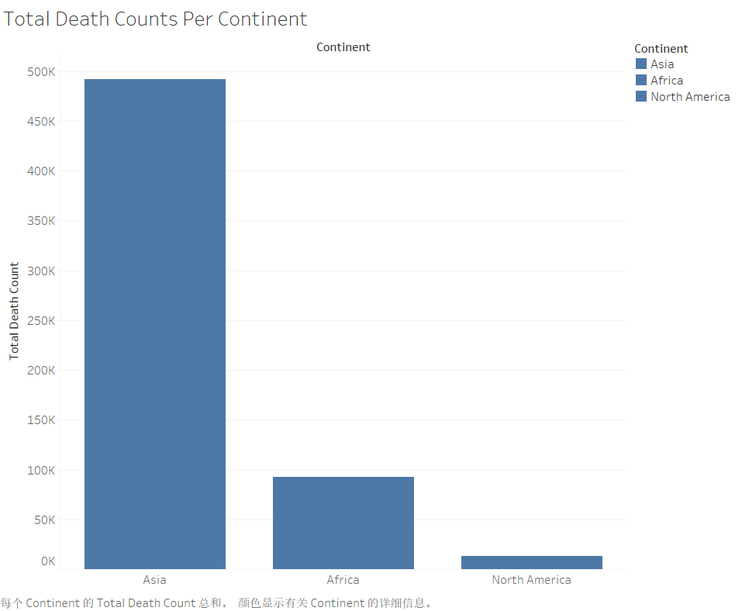

Slide 4
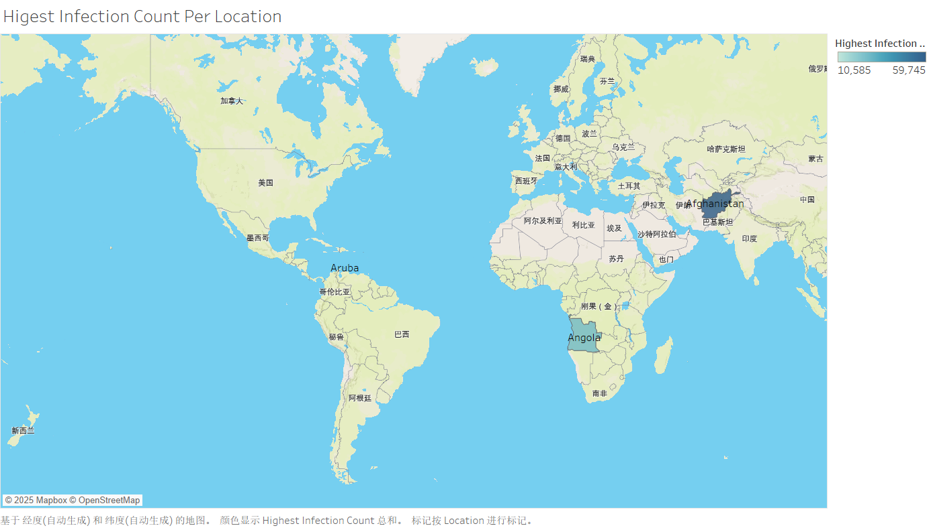

Slide 5
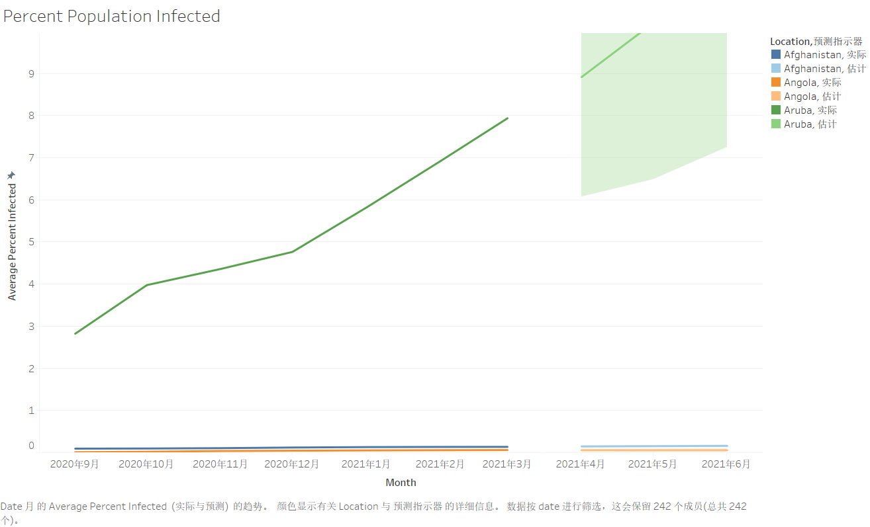

Slide 6
